Slide 1
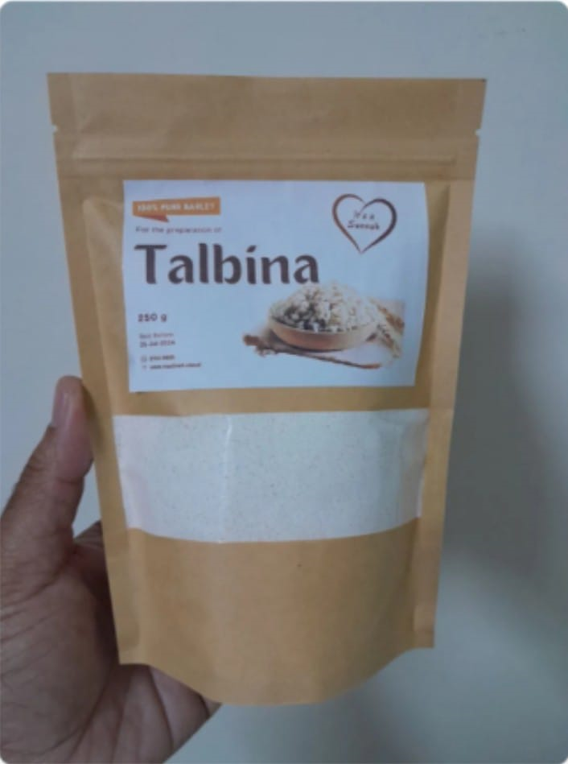

Talbina Bliss Paste – Premium Functional Health Spread
“Wholesome comfort from Sunnah – nourished with barley & dates.”
New product development project

Slide 2

Product Concept
Talbina Bliss Paste is a modern functional health spread made from barley flour and dates paste, inspired by Sunnah food principles. It serves as:
- A Breakfast Spread,
- A base for smoothies or desserts, or
- A nutritious supplement for all age groups
It provides natural energy, gut friendly nutrition, and adaptogenic benefits.
Product Type: Semisolid functional paste
Spread Category: Functional & Nutraceutical
Food Target Audience: Health-conscious consumers, diabetics, athletes, elderly Key Value Propositions 100% natural ingredients with no added preservatives Probiotic enriched for gut health support Balanced nutritional profile with functional benefits Inspired by traditional wellness practices

Slide 3
Recipe (1Kg batch formulation)
Ingredients
Quantity
Rate (Rs./kg)
Cost(Rs.)
Function
Barley Flour (roasted) 380g 180 68.4 Base, Beta glucan source
Dates Paste 320g 300 96.0 Natural sweetener, antioxi
Skim Mik Powder 40g 800 32.0 Protein enrichment
Flaxseed Powder 50g 450 22.5 Omega-3, Fiber
Olive Oil/ Coconut oil 60g 700 42.0 Mouthfeel, lipid balance
Chia Seed(soaked 1:3 water) 30g 900 27.0 PUFA, thickener
Cinnamon 2g 2000 4.0 Natural Flavor
Natural antioxidant (Vit E / 1g 3500 3.5 Shelf stability
rosemary extract)

Slide 4
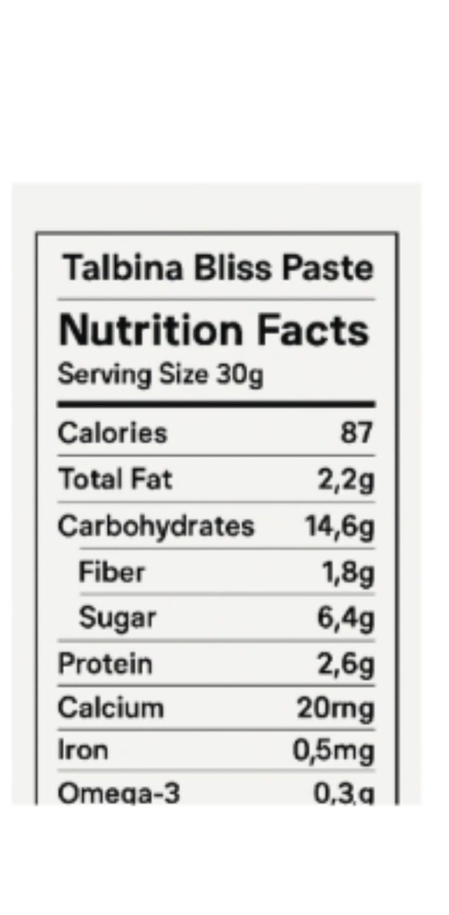
Nutritional Profile(Per 30 g serving)
Nutrient
Approx. Value
Energy 120 - 140 kcal
Protein 4 - 5 g
Fat 3 – 4 g (mainly unsaturated)
Carbohydrates 18 – 20 g
Fiber 3 - 4 g
Iron 1.5 ,mg
Calcium 50 – 60 mg
Antioxidants High (from dates + seeds)

Slide 5
Processing Steps
Lab Scale Process
1. Ingredient Prep:
Clean and roast barley flour at 80-100°C for nutty flavor.
Soak dates, remove seeds, and grind into smooth paste.
2. Blending:
Mix barley flour, date paste, and functional ingredients (flax, chia, oats).
3. Cooking:
Heat mixture at 85-90°C for 10-15 min to thicken and sterilize.
Add oils, flavors
4. Homogenization:
Blend to smooth, uniform paste.
5. Filling & Packaging:
Hot-fill in glass jars or laminated pouches.
Seal, cool rapidly.
6. Storage: Ambient storage (25°C) for up to 3-4 months.

Slide 6
Equipments
Lab Scale
B. Industrial Scale
Hot plate or double boiler
Blender/grinder
Beaker/stirrer
Jar sealer
Texture analyzer (optional)
Microbial plates & moisture mete
Roaster,
steam kettle,
homogenizer,
pasteurizer
Form-fill-seal machine
C. Quality Control Tests:
pH (4.8-5.5)
Aw (≤0.6)
Moisture (%
)Microbial load
Sensory evaluation (9-point scale)

Slide 7
Product Nature
Attribute
Category: Functional traditional paste / Health spread
Form: Smooth paste (ready-to-eat)
Texture: Thick, creamy, spreadable
Color: Light brown to caramel
Flavor: Sweet malty with date aroma
Target Consumers: Health-conscious adults, kids, elderly, Muslims preferring Sunnah-based foods
Shelf-life: 3-6 months (depends on moisture and packaging type)
B. Shelf Stability
Moisture Content: <12%
Water activity: <0.60
Preservatives: Thick, creamy, spreadable Natural Antioxidants (vit E, rosemary)
Packaging: Airtight, opaque pouch/jar
Storage: Cool, dry place

Slide 8
Market Strategy
Positioning
C. Packaging Design
"Functional Sunnah Superfood“
"Natural energy & gut-friendly "
Earth-tone jars or sachets with Arabic calligraphy-inspired labeling.
QR code for benefits and recipe uses.
B. Target Market
D. Variants (Future Expansion)
Health-conscious urban consumers
Muslim families
Fitness and wellness enthusiasts
Talbina Bliss Cocoa
Talbina Bliss with Almond & Honey
Talbina Bliss with Probiotic & Cinnamon
C. Marketing Channels
Online wellness stores, Islamic nutrition shops, organic outlets
Cafés & breakfast bars for B2B use
Influencer marketing focusing on "Sunnah foods with science

Slide 9
Financial Snapshot
Packaging (premium jar)
Processing (labor + energy)
Total Production Cost
Retail Price
Cost Component
Estimated (per 1 kg batch)
Ingredients
Rs. 550
Rs. 150
Rs. 100
Rs. 800/kg
Rs. 1200-1300/kg
Profit Margin: ~40-50%
If sold in local market (mass):
Use pouch packaging reduce packaging cost to Rs. 50/kg
Retail price: Rs. 950/kg
Profit margin: 25-30%

Slide 10
Additional Production Cost
Labor & Processing
Utilities
Quality testing & overhead
premium vs pouch | Rs. 1200 vs 950
Cost Component
Estimated (per 1 kg batch)
Packaging
Rs. 150
Rs. 100
Rs. 30
Rs. 20
Total cost of production:
= Rs. 550 (ingredients) + Rs. 300 (processing & packaging)
= Rs. 850 per kg
Profit: 570 Rs. in premium vs. 320 in pouches
Margin: 47.5% in premium vs. 33.7% in pouches

Slide 11
GROUP MEMBERS:
AQSA KANWAL 2022-fste-017
ALI RAZA 2022-fste-048
NEHA KHAN 2022-fste-047
ALI ABBAS 2022-fste-
AREESHA FATIMA 2022-fste-

